Slide 1

BookZilla
Taiwo Akinwale (200430975)
Alvin Tolentino (200433749)
Quing Rosete (200449566)
Nov. 28, 2023
Notes:
*Group Members introduce theirselves*
Our website is BookZilla.

Slide 2
Agenda
Introduction
Problem Definition
Design Requirements
Solutions
Project Management
Conclusion and Future Work
Notes:
The Agenda for today is to through our website, Bookzilla.
We will introduce the idea, problems that we encountered, the design requirements, solutions to said problems, project management and of course, our conclusion and what we hope to work on in the future.

Slide 3

Introduction
BookZilla is like an IMDb site but for books
Allows users to create a community of book readers
A form of discussion, Rating system, A way to add books that aren’t in the database are needed for the site
Notes:
Bookzilla is a site that is similar to IMDb but instead of movies, its focus is books.
There are many book lovers in the world, and these same people want to share their love and passion for these books with other people who also love it.
This is what Bookzilla is all about.
Bookzilla allows users to express their love for books and share this same love with those who love it as much as they do. Of course, there is also room for criticism.

Slide 4
Problem Definition
There are other websites that also try to accommodate book lovers
There aren’t many websites that are directed toward book lovers
Another problem that we encountered is similar functionality from multiple websites
Notes:
The main issue that we are trying to solve is creating a platform for book readers to be able to express their thoughts and opinions on their favourite books. In today’s digital age, there has been a noticeable negligence towards the book reading community as there are noticeably less platforms directed towards their wants and needs of such websites.
Although there are similar details about our website that can be found in existing websites, there are certain differences that divide us from them.
IMDb is an example as they used to have a discussion forum, but they removed it as of February 2017. This is a large part of our website as we want readers to be able to have that freedom to talk about their favorite books with other users.
Another competitor would be a site like Reddit, which is just a general discussion forum page. However, our goal is to cater specifically to readers. Having that spotlight and focus on a specific group of people will help us make changes and upgrades to the website that readers would like specifically. This also allows the users to find their “group” efficiently.
While these sites have certain similarities to ours, neither of them have it all. Our goal is to be the one website that is dedicated to the book reading community, providing them with a website that is specifically made for the book community.

Slide 5

Design Requirements
Certain functions that we have added to our website is the ability to have discussions with other users about specific books, rating books, and requesting books that are not already in the database.
The goal is to create a community for book readers to be able to share their thoughts on their favorite and most hated books.
Notes:
Some functionalities that we have implemented into our website is a form of rating system so that readers can rate books that they have read. This is to allow the users to express their feeling about the book without having to publicly express their opinions.
Another detail that we added was a way to discuss, which is implemented in the form of comments. This allows users to further expand on their thoughts about the book that they have read. This also opens the possibility to have conversations with other users about their thoughts on the book. Whether it be love, hate, confusion, whatever the user feels towards the book. As a result, the addition of form of discussion, the main purpose is to share the love for the book. However, not everyone will like the same things and the same applies to books.
A way to add books that aren’t already in the database is also important as there are many books that have been published in the world. The book that the user is looking for may not necessarily be in the database. Therefore, being able to add these books by the users their selves is going to allow the database to expand exponentially.

Slide 6
Solutions
Solution 1 | Solution 2 | Final Solution
Create a website exactly like IMDb | Make a website like Reddit | Take functionality from multiple existing websites and implement them into one
We did not pick this for copyright reasons, and it did not cater enough towards the book community | While this is better than IMDb because of the discussion feature, it was still missing some key components | By doing this, we take all the functionality that a book lover would want and put it in one site making it the premier website directed towards bookies.
The features this had was a rating system and a database for books. Lackluster overall. | The features this solution had was a discussion forum, but it was missing visual representation and the ability to rate books. | This takes the positives from both solutions and combines them creating a website that is dedicated toward the book readers.
Notes:
While the website may not have big environmental factors, it does impact the society by giving a niche group of people a website that they can use in their everyday life. As reading is still a popular hobby, many people will be happy to find out that they are still being accommodated in a technologically advanced world.

Slide 7
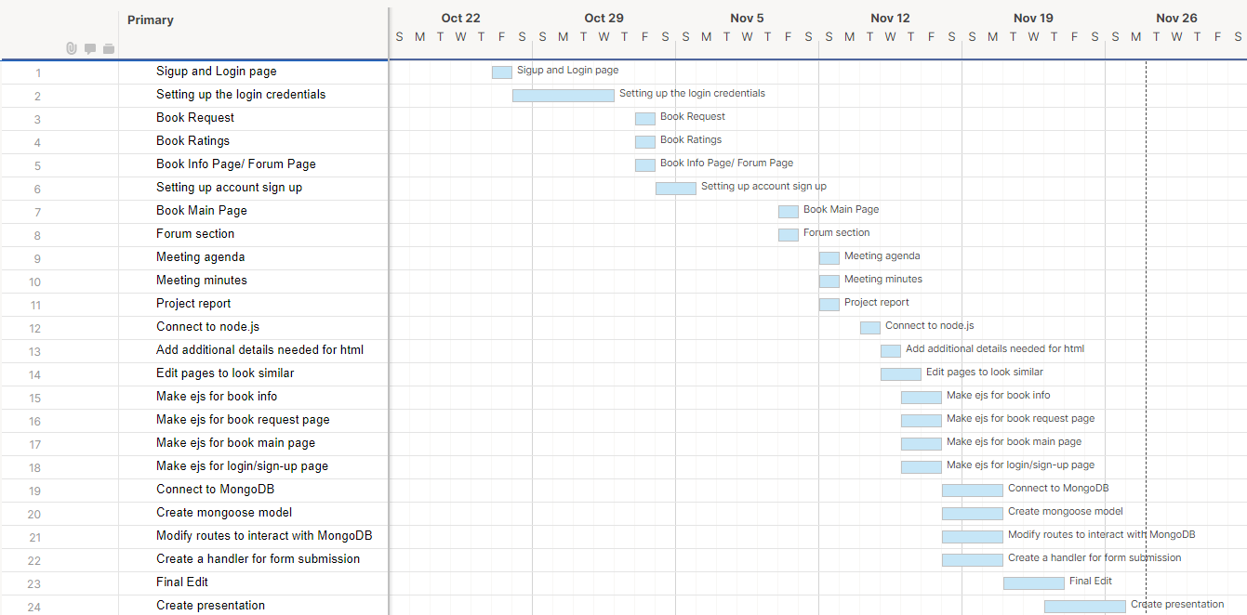
Project Management
Gantt Chart
Notes:
This is our gantt chart and it depicts the managing and planning that we did over the course of the project. Every week, we worked on our management files such as meeting minutes. This also contains other reports such as the project report and the updates towards our website. The addition of certain features is also in here, as well as EJS that was added.

Slide 8

Demonstration

Slide 9
Conclusion and Future Work
Bookzilla is a good starting point
Continue Improving Bookzilla
Other websites that will help students
Notes:
To conclude, the website we worked on, Bookzilla, is a good starting point for our software engineering careers as it allowed us to see the intricacies of running a website and other factors that may not be seen from the surface.
This is a good example, and sneak peek as to what we can expect in our careers as aspiring software engineers. There were many bumps in creating the website and there will continue to be as we improve this website. We truly believe that this website can go a long way, especially knowing that the community of book lovers do not get much attention as others.
As we continue to work on Bookzilla, we hope to keep gathering experience and improve ourselves along with the website.
As for future projects, we are interested in websites that will help students such as a class tracker that will help them keep track of classes they need to take for their major, etc. Another idea we had was to add a budgeting website that tracks student spending and states an allowance that students would have for certain activities based on their monthly expenses and needs.
I think that dedicating websites to students as students would be a great idea as we know the struggles that other students face as well.

